Slide 1

Spotify Recommendations
Catey, Fiona, Shrey, Rodolfo

Slide 2
Methodology
STEP 1
STEP 2
STEP 3
STEP 4
EXPLORE PROJECT SCOPE
GATHER DATA
DATA STEPS
MODELS & EVALUATION
RESEARCH DIFFERENT APPROACHES TO MAKE RECOMMENDATIONS ON SPOTIFY
APPROPRIATE DATA, RELEVANT RELATED WORKS, USEFUL INFO, DATA ANALYSIS PLAN
DATA UNDERSTANDING, DATA PREPARATION, DATA ANALYSIS
IMPLEMENT MODELS & EVALUATE RECOMMENDATIONS GENERATED

Slide 3
CRISPR-DM I - Business Understanding (BU)
What was our aim and business relevance?
Create song recommendations based on the musical taste of individual users
Research Question → Data Science Question
Provide recommendations for songs based on clusters and associations with songs of similar features

Slide 4
CRISPR-DM II - Data Understanding (DU)
Data we collected:
We used the genres_v2 dataset, a dataset of songs in Spotify containing a variation of features and genres
https://www.kaggle.com/datasets/mrmorj/dataset-of-songs-in-spotify
Data quality & feature importance:
Many data points (around 40,000)
Goal: avoid overfitting
10 audio features
15 genres

Slide 5
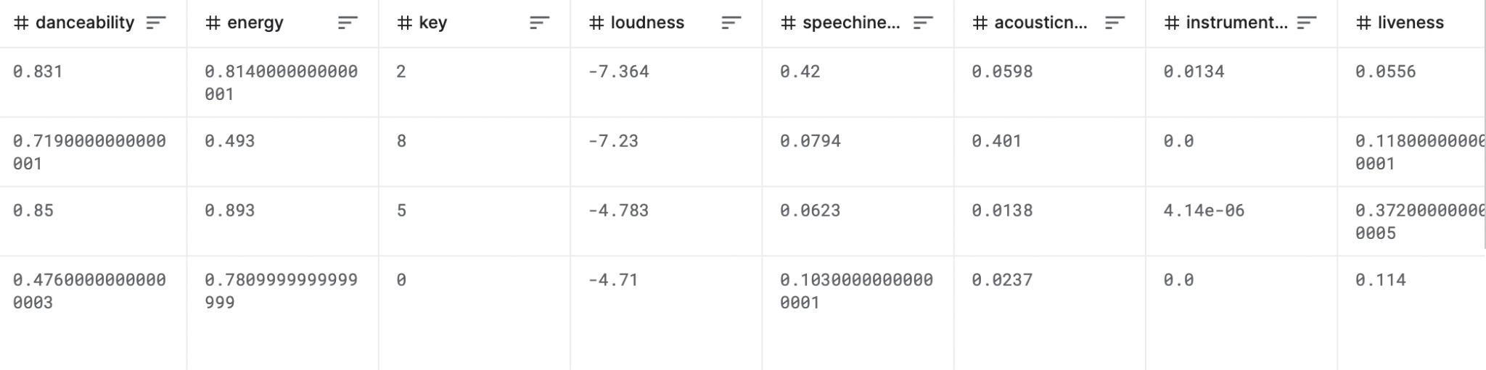
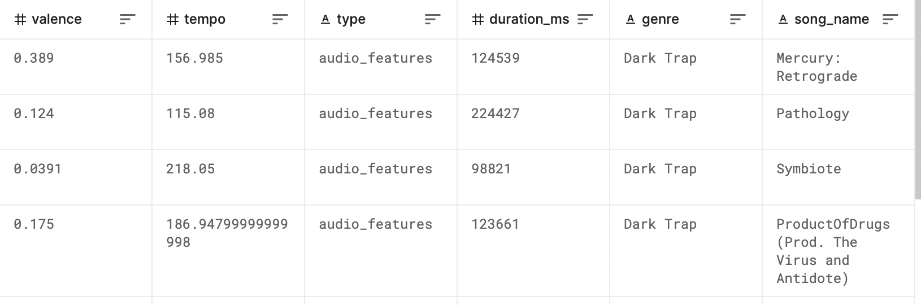
A quick glance
…
…
Notes:
This is just a quick overview of our dataset (including only relevant columns). We had a lot of metadata for a lot of songs. You can see the format of our data and how it was organized.

Slide 6
CRISPR-DM III - Data Preparation (DP)
Data cleaning:
Remove rows that don’t have a song_name
Removed non-numerical columns for scaling
Create new dataframe to scale and use for modelling (preprocessing is necessary)
Attribute relevance:
Check how every feature varies in each of the genres (sample code on next slide)

Slide 7
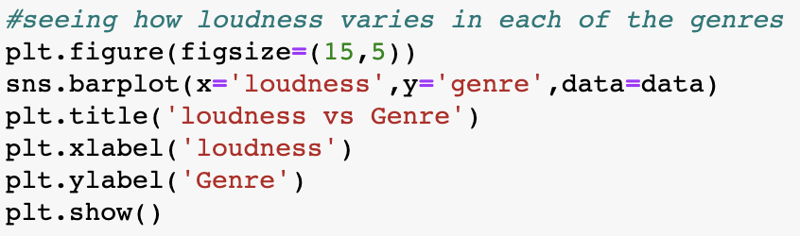
CRISPR-DM III - Data Preparation (DP) II
Attribute relevance code example:

Slide 8
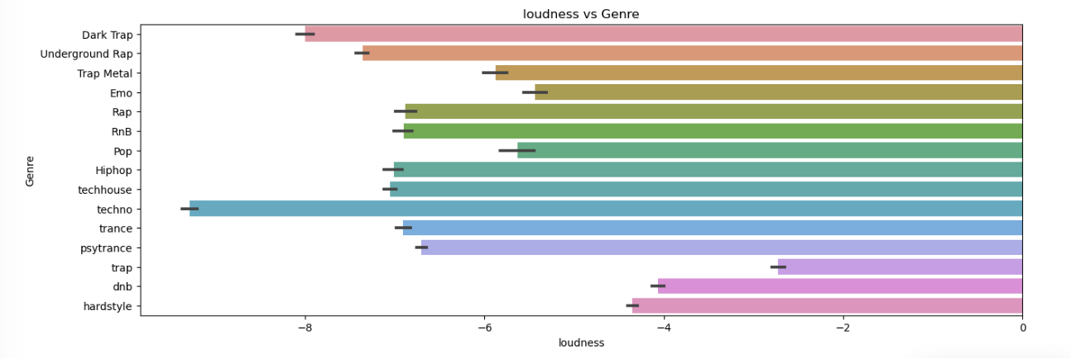
CRISPR-DM III - Data Preparation (DP) III
Attribute relevance visualization example:

Slide 9
Features & Data Chosen
The dataset included 10 features
The dataset included 15 genres
The data set included around 22,000 songs (after cleaning)
In the data understanding and data preparation stages, we accounted for every feature and every genre
Drew comparisons between feature importance per genre

Slide 10
Feature Manipulation
Accounted for in data preparation step
Compared how features are distributed to understand which are skewed and which are normally distributed
Cleaned data for better interpretability
Scaled data for better preprocessing

Slide 11
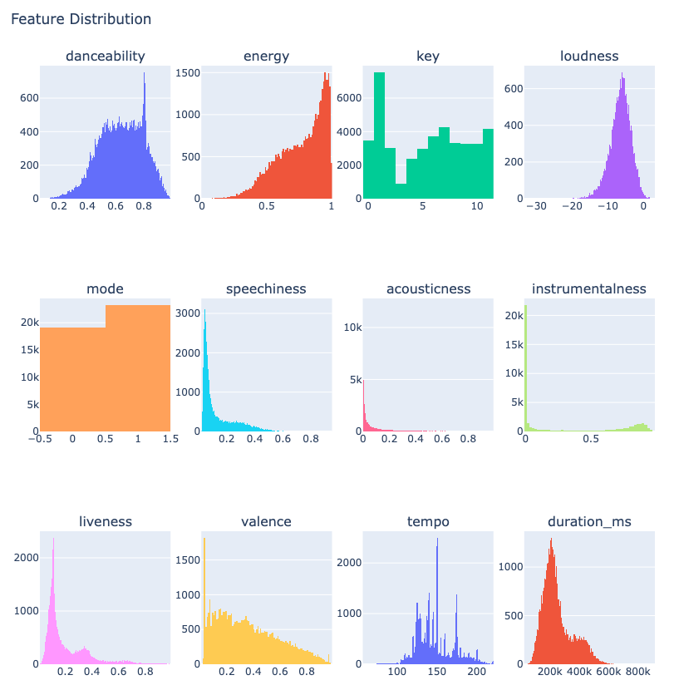

Slide 12
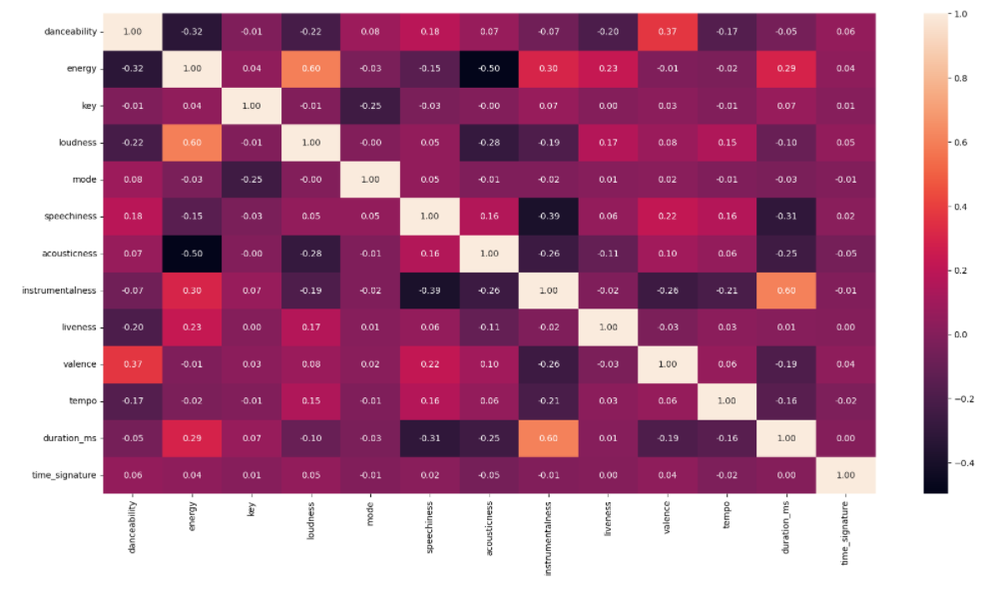
Feature Correlation
Correlation with regards to the music features allows us to find similarities in songs
Ex. Strong correlation between energy and danceability
Heat map visualization for correlation strength - brighter colors for stronger correlation

Slide 13
DU + DP
The majority of our time was spent on data understanding and data preparation so that we could make sure our data was appropriate, relevant, and interpretable to make valid recommendations

Slide 14
CRISPR-DM IV - Modeling (M)
Models implemented:
Unsupervised learning
K-means model I
All features
K-means model II
Selected Features
Hierarchical clustering
All features
Selected features

Slide 15
K-Means
Steps
Initialize k-means
Label clusters
Get silhouette score per number of clusters
Compare results: some features vs all features

Slide 16
K-Means II
Continuation
Exploratory data analysis helped to choose important features for our k-means model
Reasoning behind feature selection: corr plots, bar graphs, feature distribution
Plots of features against genre helped identify more important/varying features
Feature distribution also helps identify how features are distributed among genre

Slide 17
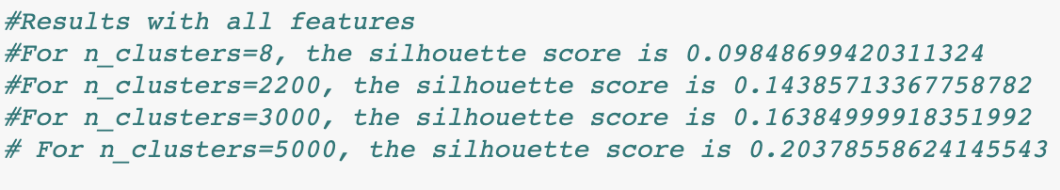
K-Means III
Results with all features

Slide 18
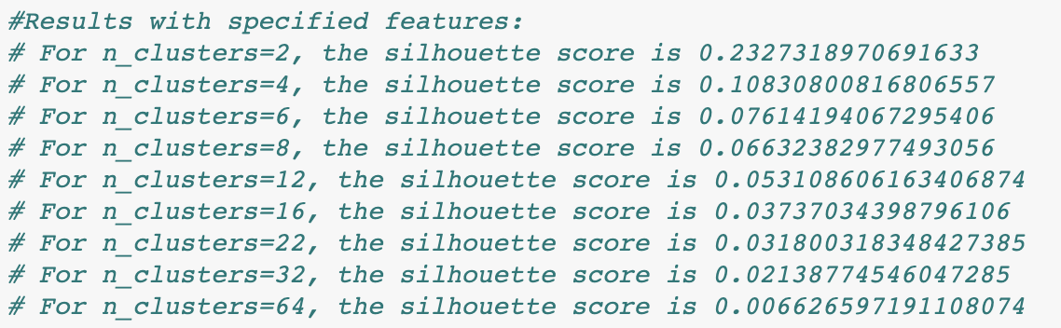
K-Means IV
Results with specified features
The closer the silhouette score is to 1, the better it is!

Slide 19
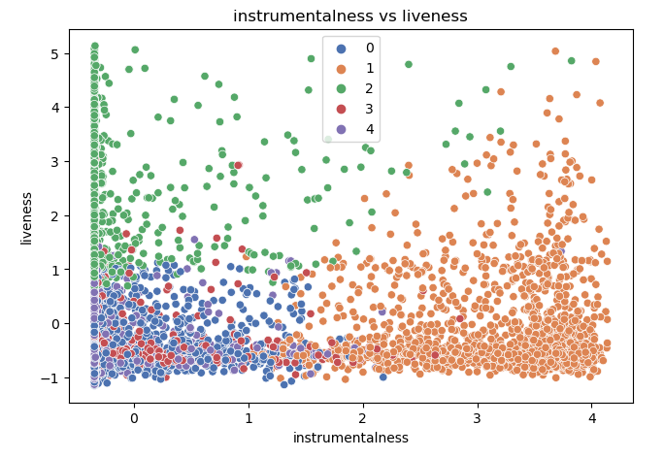
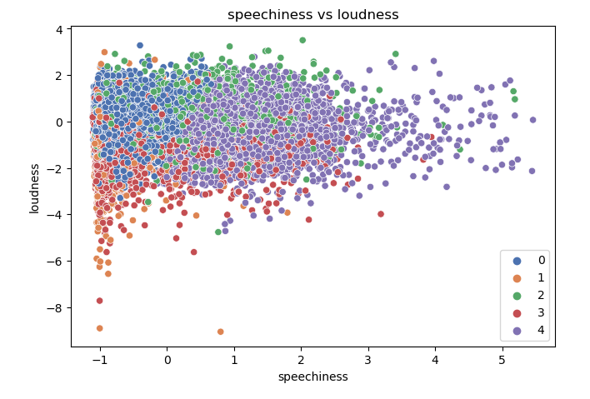
Feature Comparison
Notes:
5 different clusters compared to different features

Slide 20
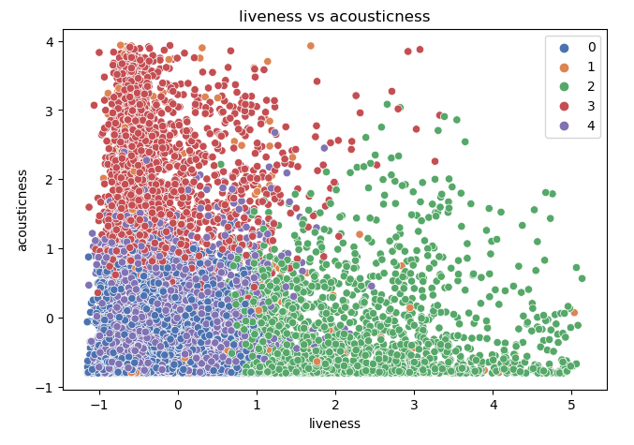
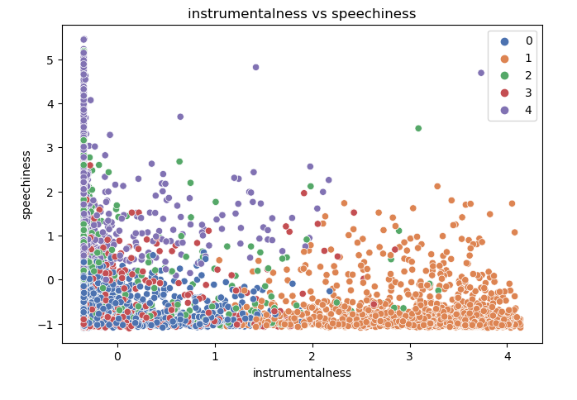
Feature Comparison II

Slide 21
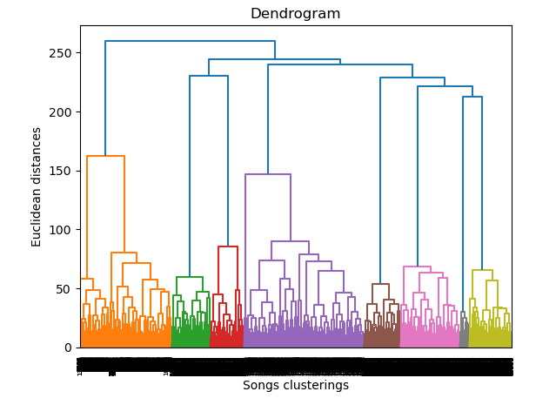
Hierarchical Clustering - All Features
AN ALTERNATE APPROACH
Our first step was finding the optimal number of clusters for our model, since we must specify that when instantiating it.
We generate a dendrogram to derive this value.
Found 16 clusters to be the optimal number
Great silhouette score
More clusters than genres allows us to make more specific recommendations
Notes:
As an alternate approach, we went with a hierachical clustering model to test against our kmeans model. We started with one that included all features

Slide 22
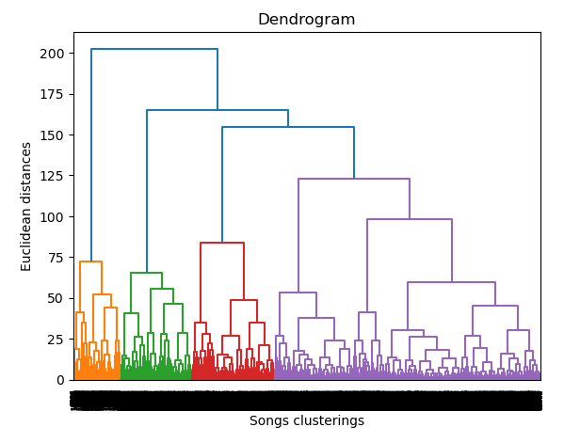
Hierarchical Clustering - Selected Features
The dendrogram looks different if only a few features are selected
18 clusters is optimal
Selected features were loudness, speechiness, acousticness, instrumentalness, and liveness
Nicer visualizations
Not the best silhouette score.

Slide 23
CRISPR-DM V - Evaluation (E)
How does our model perform in relation to our recommendation goal?
Different models had different benefits and drawbacks - but overall the hierarchical clustering model performed best
K-Means model with many clusters and all features performed well
K-Means model with fewer clusters and selected features had more understandable and cleaner visualizations
Clustering model with hierarchical clustering on all features performed better than that with selected features
Overall, hierarchical clustering performed the best with all features.
Notes:
Again, we used the silhouette score to evaluate clustering performance.

Slide 24
CRISPR-DM VII - CRISPR-DM VI - Deployment (D)
Steps:
Exploratory data analysis helped understand data and do better feature selection for clustering models
Made k-means model with high number of clusters and ALL features and a recommender system from that model
Another k-means model with low number of clusters and SELECTED features (for better and readable visualizations)
Alternate clustering model using hierarchical clustering with ALL features, visualizations, dendrogram, and recommendation system
Another hierarchical clustering with SELECTED features (for better and readable visualizations

Slide 25
CRISPR-DM VII - CRISPR-DM VI - Deployment (D) ||
Results:
Models with all features performed better in both clustering models
Hierarchical clustering performed better than k-means
Used hierarchical clustering as final model for recommendation system
Tried different aspects like varying k-values, feature numbers and chose those with better silhouette scores

Slide 26
LIVE DEMO

Slide 27
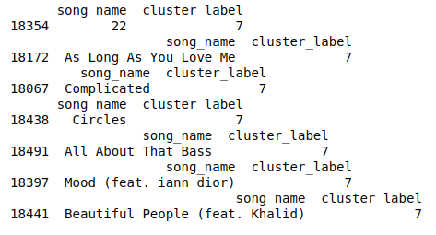
Recommender System
The end recommender system chooses random songs from the same cluster
Checks output to ensure none of the songs recommended are repeats
Lists song title and cluster label - in this all songs are from cluster 7

Slide 28
Evaluation against successful project requirements
Domain knowledge
Reviewed multiple related works & research
Big data
Had many data points (combination of features/genre)
Clean data
Removed empty rows to prevent false results

Slide 29
Evaluation against successful project requirements II
Unbiased data
Did not include misleading of irrelevant data
Made sure each datapoint represented the music being referred to
The capacity of act
Made certain to avoid a high cost and rigid system
Usable & cost efficient
Measurability of Return of Investment (ROI)
Deployable
Able to retrieve music recommendations easily

Slide 30
Drawbacks & Challenges
Main difficulties lied in choosing which models to test and comparing the results
Choosing parameters such as which k-values and features would give the best model was also a challenge
Data understanding and preparation from the kaggle dataset

Slide 31
Next Steps
What would we do given more time?
Use additional algorithms to compare to hierarchical clustering
Include more than one dataset and measure success
Consider overfitting & underfitting in more detail (check performance with less & more data points)
Turn recommendation system into a mobile app (easy to use)

Slide 32

Thank You!
Catey
Fiona
Shrey
Rodolfo

